Slide 1

ROCKBUSTER STEALTH
DATA ANALYSIS PROJECT
BY: AROOJ FATIMA

Slide 2
CONTENTS
Project introduction
Business questions
Market analysis
recommendation

Slide 3

PROJECT INTRODUCTION
Rockbuster Stealth LLC, a global movie rental company with physical stores, is adapting to the competitive pressures from streaming services like Netflix and Amazon Prime. To remain relevant, the company plans to leverage its existing movie licenses and launch an online video rental service.

Slide 4
BUSINESS QUESTIONS
WHAT
What was the average rental duration for all videos?
WHICH
Which countries are Rockbuster customers based in?
Which movies contributed the most/least to revenue gain?
WHO
Who are the Top 5 customers who have paid the highest total amounts?

Slide 5
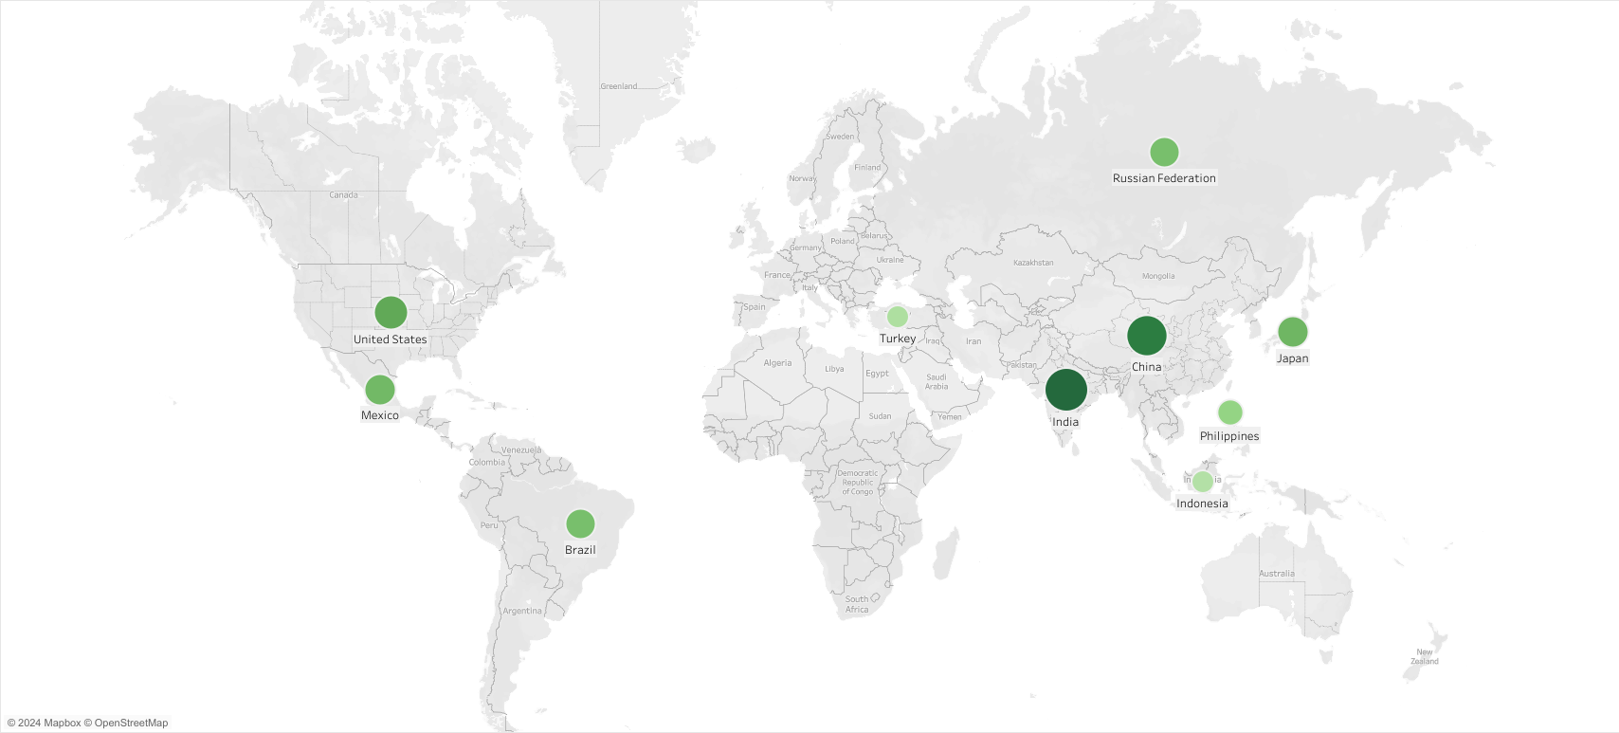
Which countries are Rockbuster customer based in? Top 10 countries with Largest customer base are India , China, United states, Japan, Mexico, Brazil, Russian Federation, Philippines, Turkey and Indonesia. India has the largest customer base.

Slide 6
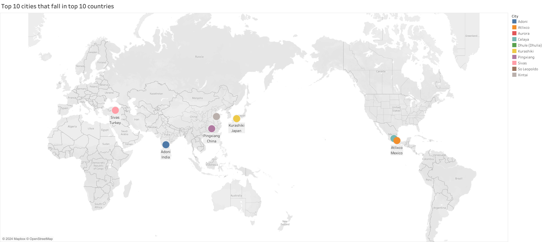
Top 10 cities that fall in Top 10 countries:

Slide 7
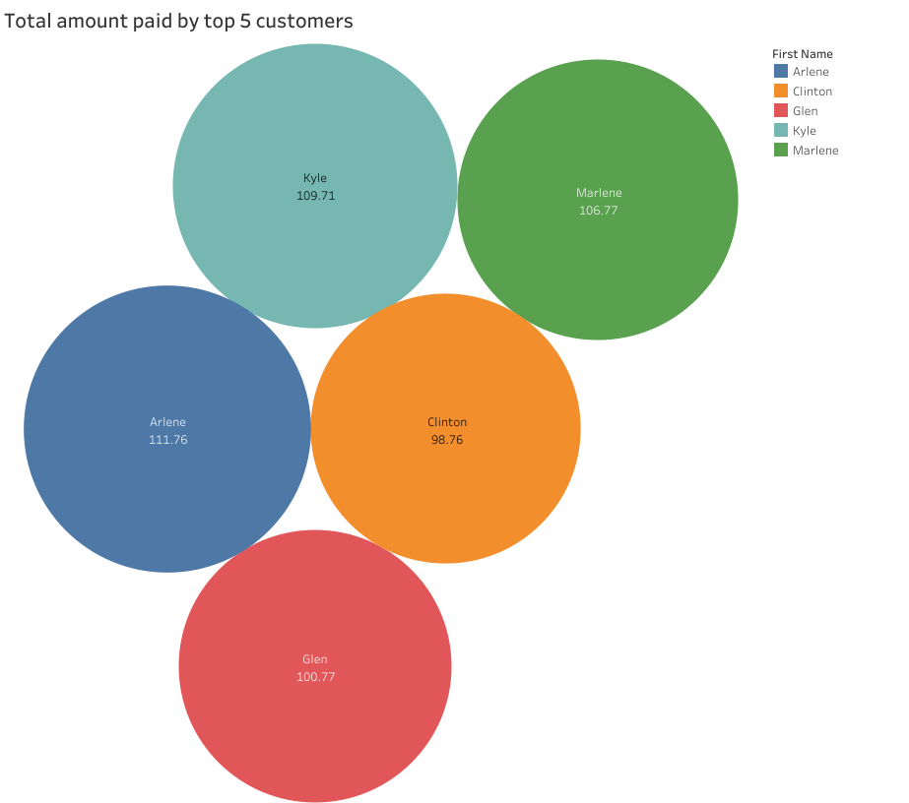
Top 5 customers who have paid the highest total amounts:

Slide 8
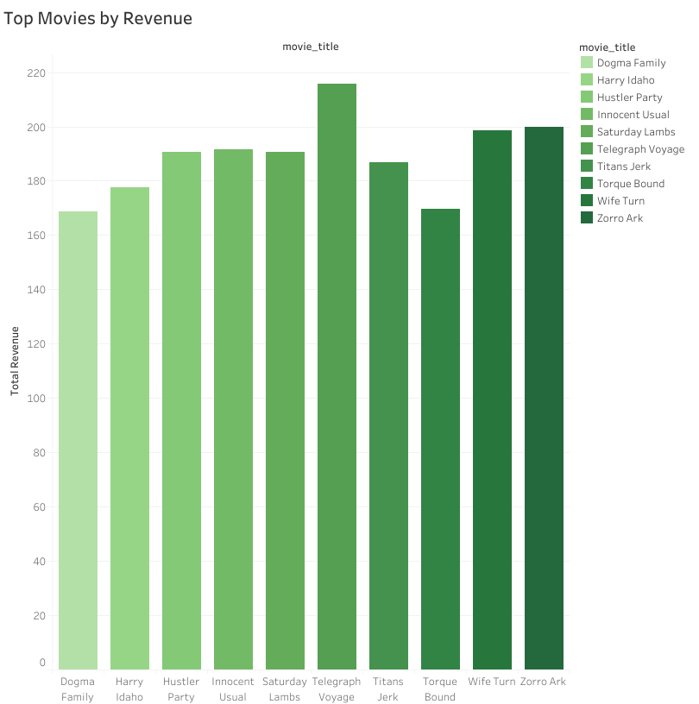
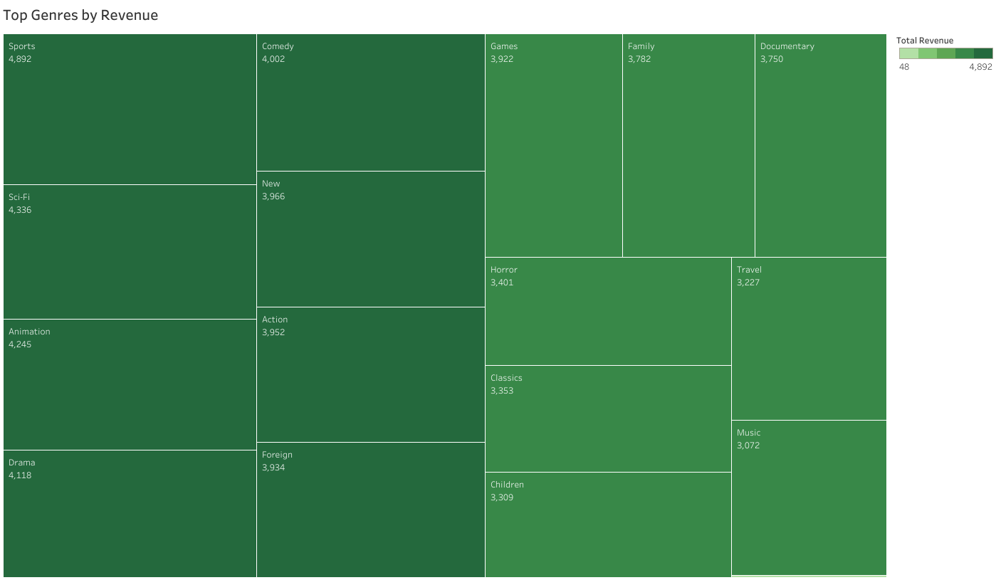
Which movies contributed the most/least to revenue gain?
Top 10 Genres by revenue gained $
Top 10 Movies by revenue gained $

Slide 9
What was the average rental duration for all videos?
 | Rental Duration | Rental Rate
Average | 4.98 days | 2.98$
Minimum | 3 days | 0.99$
Maximum | 7 days | 4.99$

Slide 10
Recommendations:
Focus on High-Potential Markets: Prioritize the Indian and Chinese markets due to their large populations and growing demand for digital entertainment. Tailor content to regional preferences to enhance market penetration.
Invest in Popular Content Genres: Focus on genres like sports, sci-fi, animation, and drama, which generate the most revenue. Expand offerings within these categories to capture audience interest.
Enhance Customer Retention: Introduce loyalty programs with incentives such as gift codes, discounts, or exclusive early access to new releases to retain customers and boost lifetime value.
Leverage Data for Personalization: Use analytics to understand customer viewing habits and offer personalized recommendations. This will improve user satisfaction and increase engagement.
Improve Accessibility and Experience: Optimize streaming for low-bandwidth users, offer multilingual support, and introduce offline viewing options to expand accessibility in emerging markets.
Strengthen Regional Partnerships: Collaborate with local creators and production houses in key markets to develop culturally relevant content, enhancing brand appeal and market relevance.

Slide 11
Tableau links
https://public.tableau.com/app/profile/arooj.fatima3827/viz/Top10countiesaccordingtocustomersinRockbusterStealth/Sheet1?publish=yes
https://public.tableau.com/app/profile/arooj.fatima3827/viz/Top10citiesthatfallintop10countries/Sheet1?publish=yes
https://public.tableau.com/app/profile/arooj.fatima3827/viz/Totalamountpaidbytop5customers/Sheet1?publish=yes
https://public.tableau.com/app/profile/arooj.fatima3827/viz/TopMoviesbyRevenue_17310506800860/Sheet1?publish=yes
https://public.tableau.com/app/profile/arooj.fatima3827/viz/TopGenresbyRevenue/Sheet1?publish=yes

Slide 12
For further inquiries, please contact: arooj.gm3@gmail.com THANKYOU

